Slide 1
Travel Planner App with AI Itinerary
Fundamentals of Data Engineering-24DEA3101
BACH-19
2420030094 – A Sindhuja
2420090033 – K Komali Hasini
2420090040 – K Rishitha Reddy

Slide 2
Problem Statement
Planning a trip manually requires collecting information about destinations, transportation, accommodation, tourist attractions, food, budget, and available time from multiple sources. this process can be time-consuming and may result in poorly organized schedules or missed attractions. traditional travel planning systems generally provide fixed recommendations and do not sufficiently adapt the itinerary to the user's interests, budget, duration, and preferences.
The travel planner app with ai itinerary aims to solve this problem by providing a personalized travel planning system. the application uses user-provided information such as destination, number of days, budget, interests, and preferred activities to generate a structured itinerary. the system helps users organize their trips efficiently and provides recommendations that are relevant to their individual requirements.

Slide 3
DEVELOPMENT
To develop a user-friendly travel planning application for creating and managing trips.
To generate personalized itineraries based on destination, duration, budget, and user interests.
To use AI techniques to recommend suitable tourist attractions and activities.
To organize daily travel schedules in a simple and understandable format.
To consider user preferences and constraints while generating travel plans.
To reduce the time and effort required for manual trip planning.
To provide budget-aware recommendations for better travel management.
To create a flexible itinerary that can be modified according to user requirements.

Slide 4
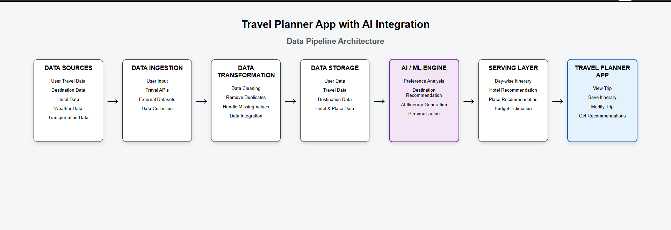
WORKFLOW

Slide 5
THANKYOU

